Slide 1

Advanced Embedded Lab
Shehroz, Nikolaos Christian

Slide 2
Plant Nurse
Temperature
Humidity
Light
Exhaust Fan
Water Pump

Slide 3
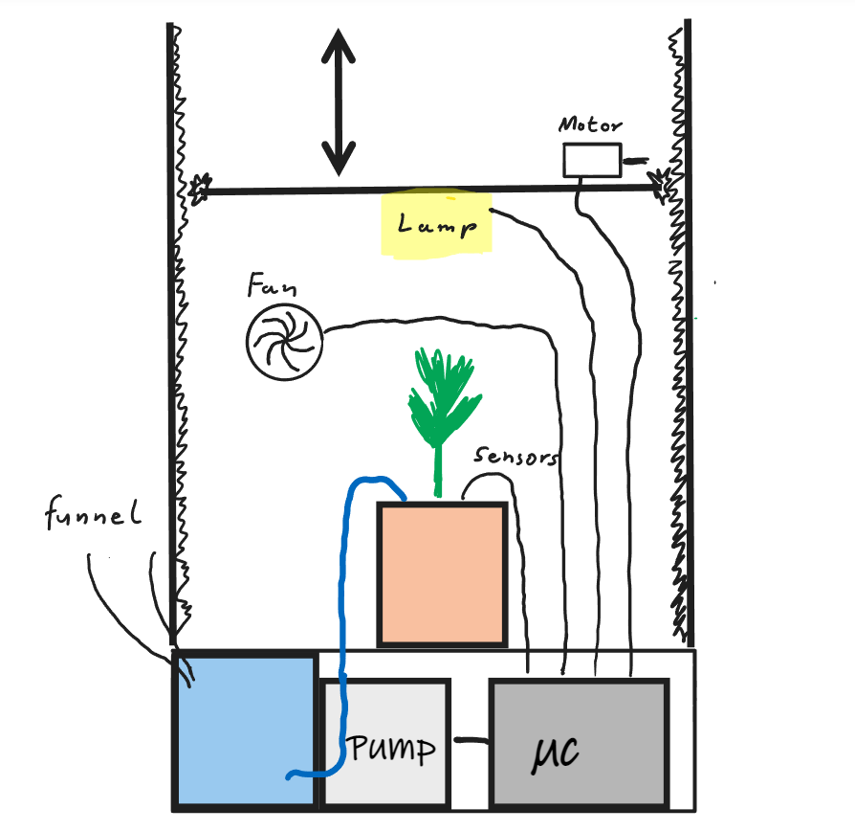
Concept Design

Slide 4
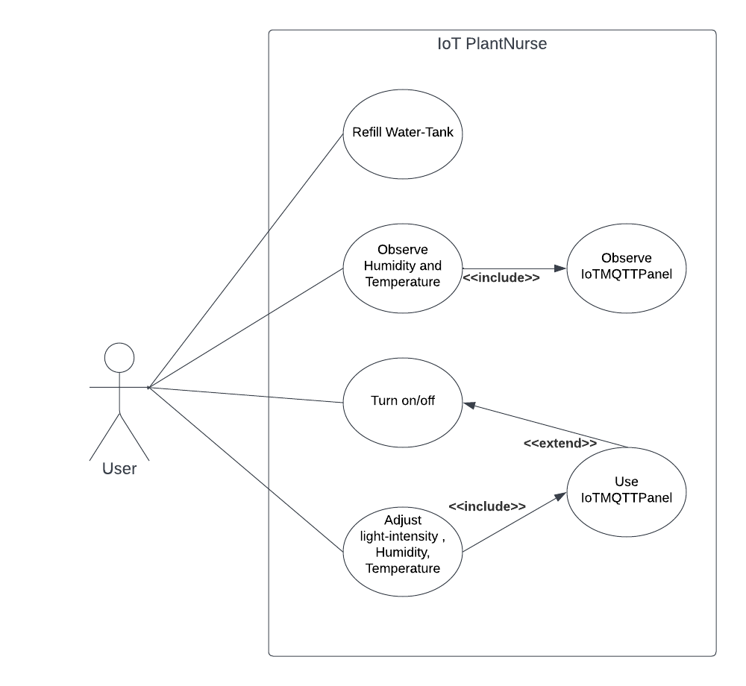
Use Case Diagram

Slide 5
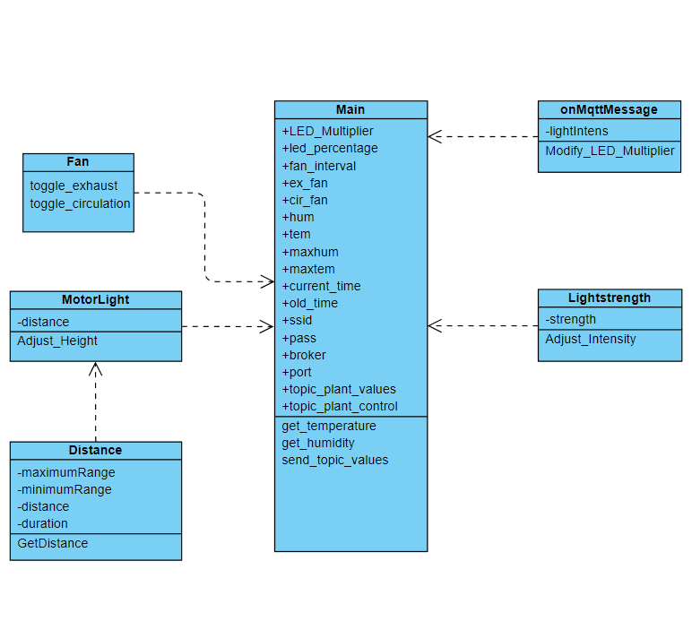
Class Diagram

Slide 6
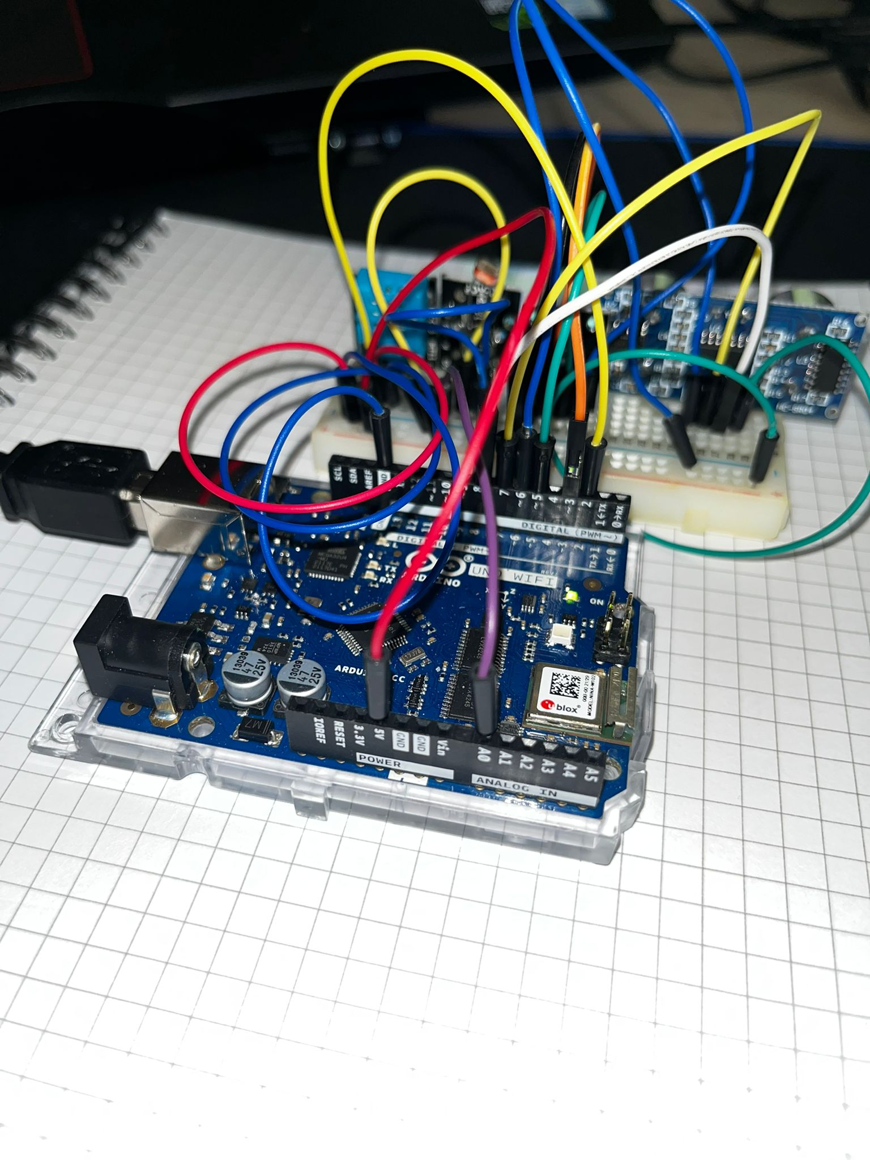
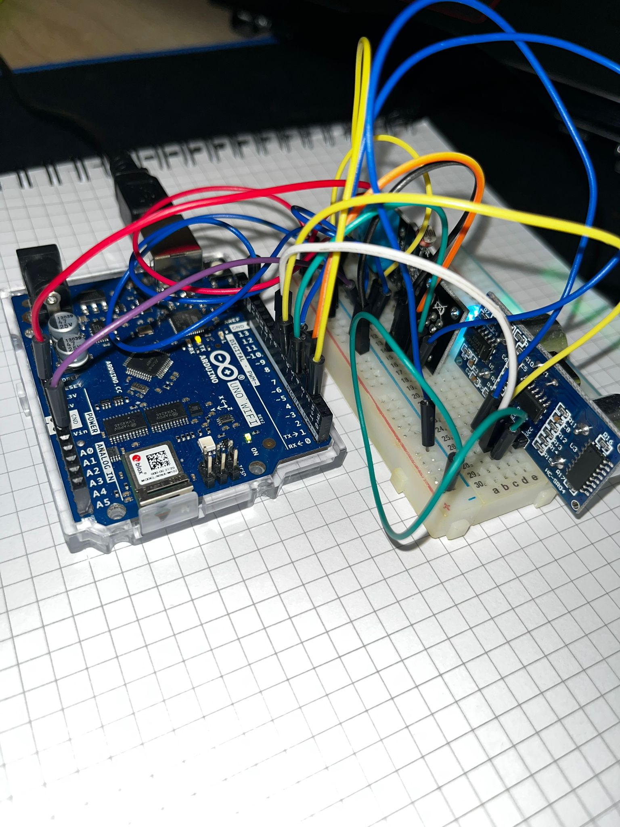
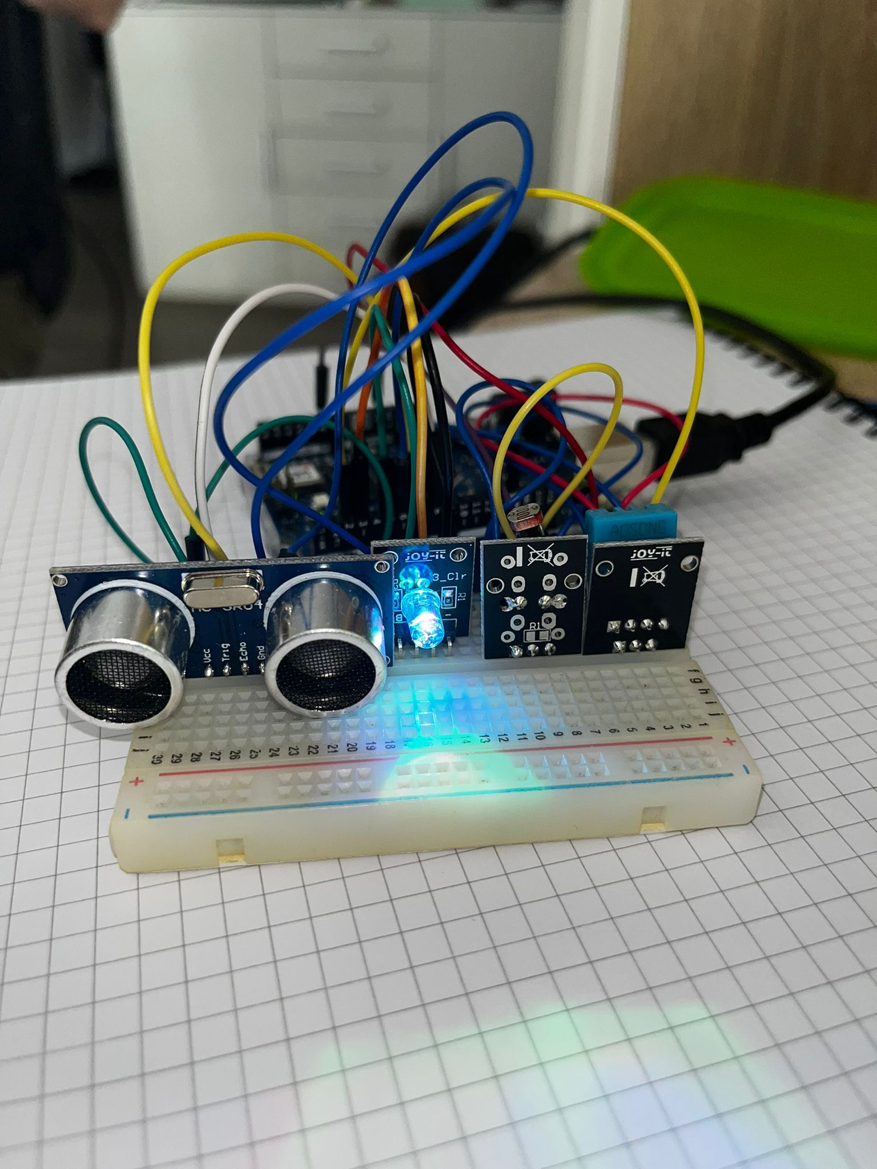
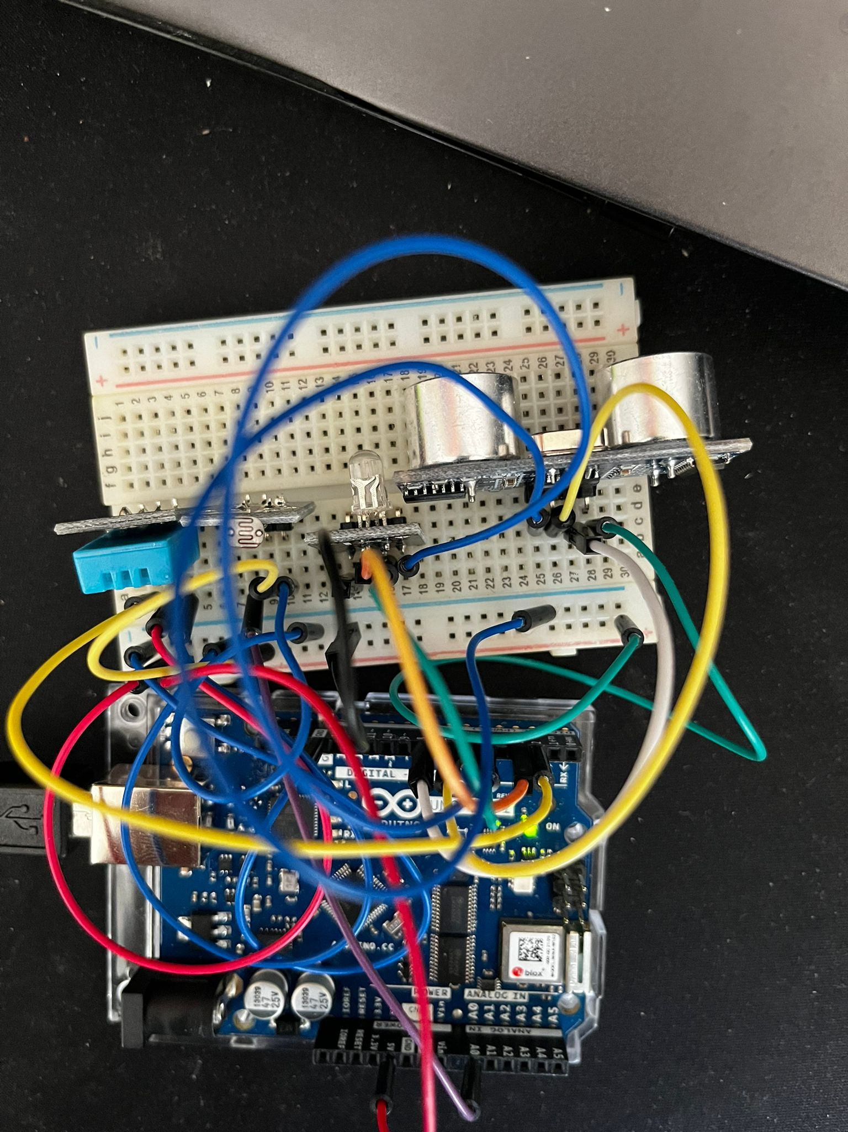
Arduino with Sensors

Slide 7
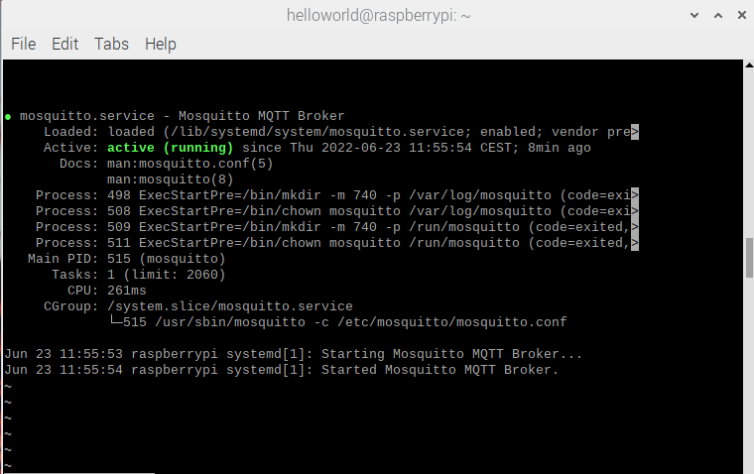
MQTT

Slide 8
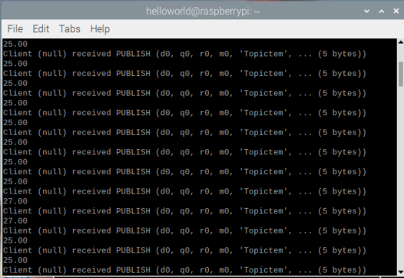
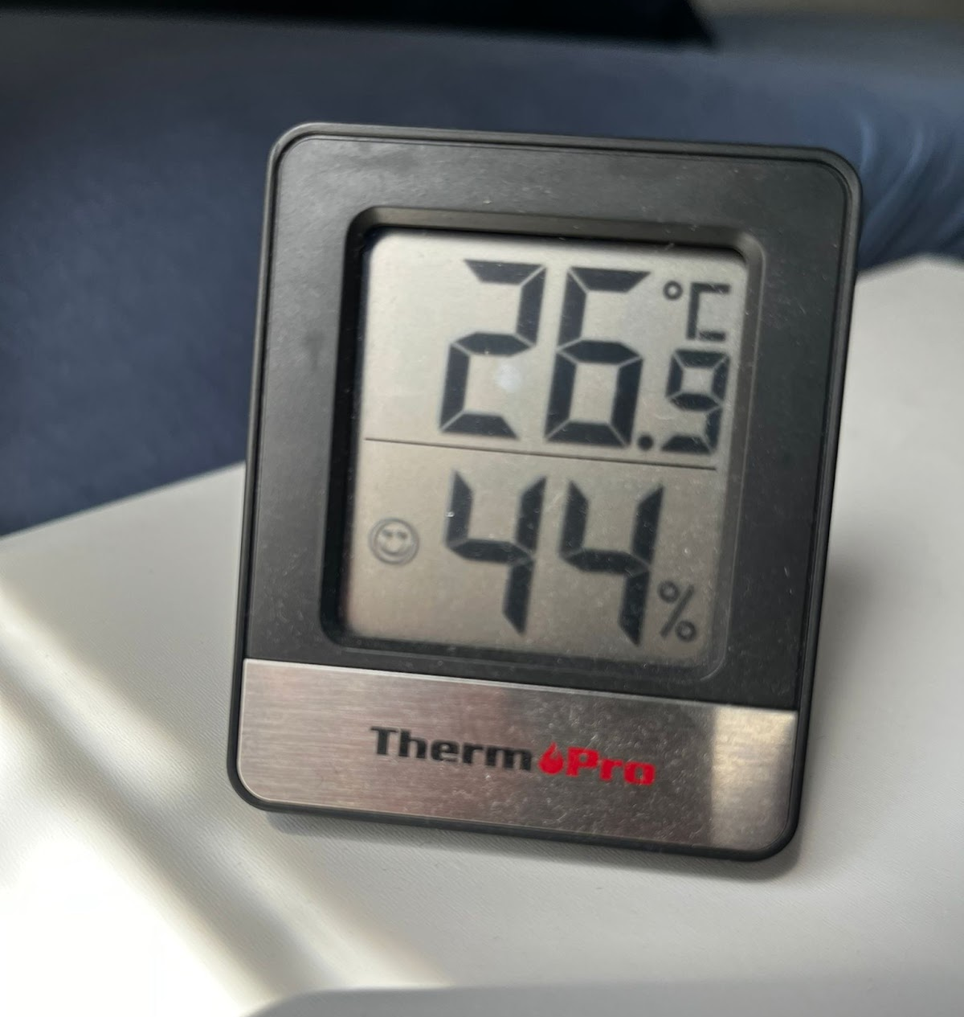
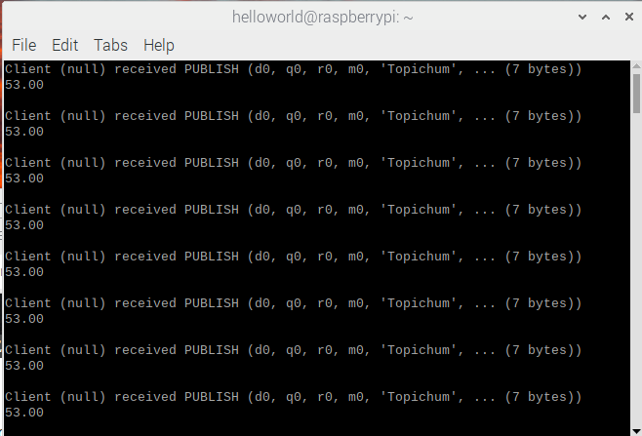

Slide 9
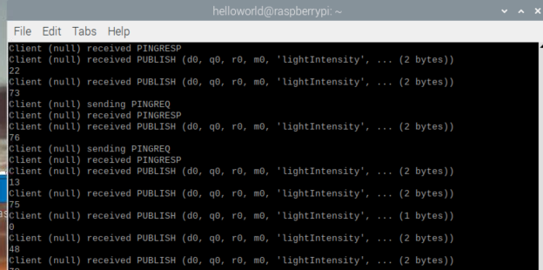
Light Sensitivity

Slide 10
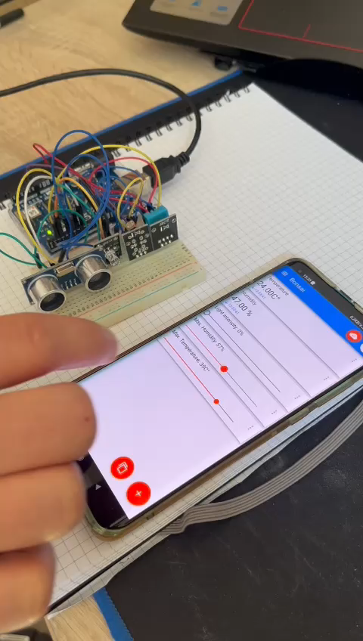

Slide 11
Future Work
serialPrint to simulate the activation time of the fans and the LED elevation motor -> has to be mapped to two digital outputs
Relay (controlled by our arduino WiFi) switches external power source for water pump and exhaust fan
chassis which is holding every component in place and a rack with a suitable gear attached on the elevation motor

Slide 12
Thanks for your attention!
Any questions? Probably yes.

